Slide 1
Hypothesis Testing Exercise
A F&B manager wants to determine whether there is any significant difference in the diameter of the cutlet between two units. A randomly selected sample of cutlets was collected from both units and measured? Analyze the data and draw inferences at 5% significance level. Please state the assumptions and tests that you carried out to check validity of the assumptions.
Minitab File : Cutlets.mtw
Ho: µ1= µ2 (diameter of cutlets between two units are same)
H1: µ1 ≠ µ2 (diameter of cutlets between two units are not same)
Test: 2-sample ,2 tail t test

Slide 2
P –value that we are getting is 0.47
P value <0.05
hence accept Ho
From this test we can say that the diameter of two cutlets are same

Slide 3
Hypothesis Testing Exercise
A hospital wants to determine whether there is any difference in the average Turn Around Time (TAT) of reports of the laboratories on their preferred list. They collected a random sample and recorded TAT for reports of 4 laboratories. TAT is defined as sample collected to report dispatch.
Analyze the data and determine whether there is any difference in average TAT among the different laboratories at 5% significance level.
Minitab File: LabTAT.mtw

Slide 4
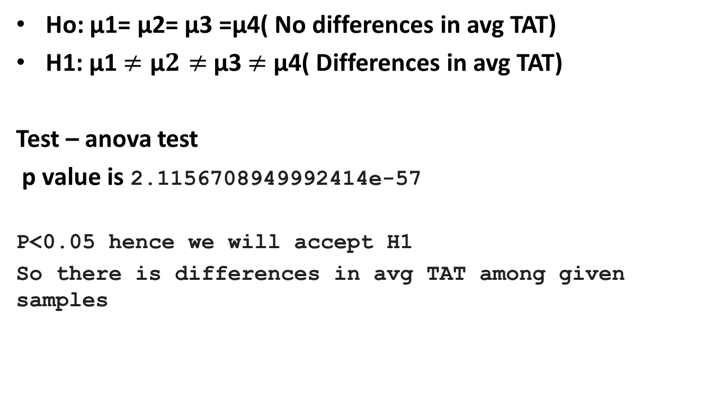
Ho: µ1= µ2= µ3 =µ4( No differences in avg TAT)
H1: µ1$≠\text{µ}2≠$ µ3$≠$ µ4( Differences in avg TAT)
Test – anova test
p value is 2.1156708949992414e-57
P<0.05 hence we will accept H1
So there is differences in avg TAT among given samples

Slide 5
Hypothesis Testing Exercise
Sales of products in four different regions is tabulated for males and females. Find if male-female buyer rations are similar across regions.
 | East | West | North | South
Males | 50 | 142 | 131 | 70
Females | 550 | 351 | 480 | 350
Check p-value
If p-Value < alpha, we reject Null Hypothesis
H0
All proportions are equal
Ha
Not all Proportions are equal
Buyer Ratio.mtw

Slide 6
Ho: Independence of categorical variables. (male-female buyer rations are similar across regions )
Ha: Dependence of categorical variables (male-female buyer rations are NOT similar across regions
Inference: As (p-value = 0.6603) > (α = 0.05); Accept the Null Hypothesis i.e. Independence of categorical variables Thus, male-female buyer ratio are similar across regions and are not related

Slide 7
Hypothesis Testing Exercise
TeleCall uses 4 centers around the globe to process customer order forms. They audit a certain % of the customer order forms. Any error in order form renders it defective and has to be reworked before processing. The manager wants to check whether the defective % varies by centre. Please analyze the data at 5% significance level and help the manager draw appropriate inferences
Minitab File: CustomerOrderForm.mtw
Ho: defective % does not vary from center
H1: defective % varies from center
Test: chi – square test
P value= 0.2771
Inference: As (p_value = 0.2771) > (α = 0.05); Accept Null Hypthesis i.e. Independence of categorical variables Thus, customer order forms defective % does not varies by centre

